Slide 1



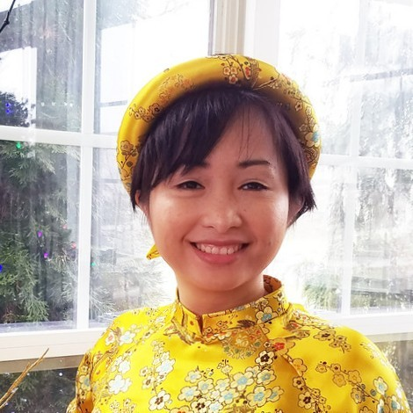







Thu Tran MT Engineer II – Dupont Vespel® Pencader
Hobbies: Family, Travel, Photography, Reading, Swimming
Chemical Process Engineer Knowledge
Handed on experience with Ceramic process, pharmaceutical process
Developed BFD, PFD, SOP for process validation
Developed DoE to determine process optimization, operational excellence
Developed product tracking process and inventory management process
Challenged equipment calibration to manipulate SPC and reliability
Measured the real-time process to improve OEE and Cost Analysis Review
Data Science Knowledge
Proficiency in development languages: MATLAB, VBA, Python
Proficiency in Database : Microsoft SQL, MySQL, Power Query
Tracked data accuracy in MES, Oracle, and Power BI report.
Developed data visualization power BI report for manufacture management
Applied Machine Learning to predict process outcome
Education
AS in Computer Programming, NCC Education
AS in Science, Community College of Philadelphia
BS in Chemical Engineering, Drexel University
MS in Data Science*, Drexel University
* anticipated 2024
Experience
2008 - 2011: Sr. UI Developer , Vinasource
2011 - 2012: Graphic Designer, GNT
2013 - 2021: Pharmacy Technician, Retails
2018 - 2019: Manufacture Engineer, Chemours
2021 - 2022: Process Industrial Engineer, II-VI
2022 - 2023: Process Improvement Engineer, IVC
2023 - Present: MT Engineer II, Dupont E&IS

